Slide 1
使用此方法 需要在初始化时在 quick setup 中
将IP Terminal Registration Mode 设置为 “Full Automatic”
IP话机侧的IP地址为 DHCP 或者手动填写IP地址

Slide 2
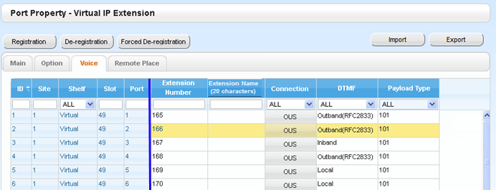

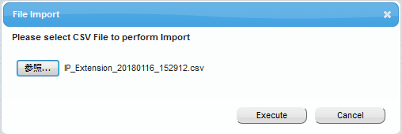
How to program? - NT registration by CSV -
Import target file must be CSV format
At least 1 port must be “OUS” to initiate “Import” process.
Data copied for the port with “OUS” status only. Port other than “OUS” will be skipped to copy from applicable raw.
If there is no port imported by some reason (non CSV file etc) then Error message will be prompted.
Import result can be checked at Web screen

Slide 3
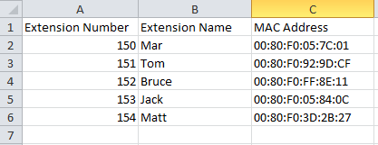
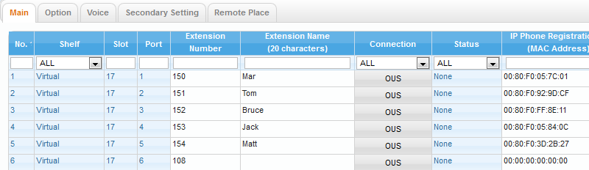
How to program? - NT registration by CSV -
raw 2-6 -> port 1-5
Data at raw 2 in CSV file will be applied for 1st port
raw 3 -> 2nd port, raw 4 -> 3rd port
etc ( raw N -> Port N-1 )
CSV raw number ≧ existing Port : data at raw beyond last port ignored

Slide 4
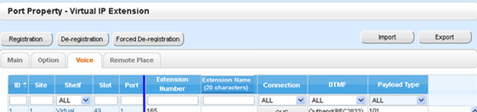
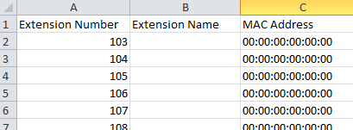
How to program? - NT registration by CSV -
Prepare to create CSV file with MAC address -New Installation-
Install V-IPEXT card and export CSV file, use as template

Slide 5
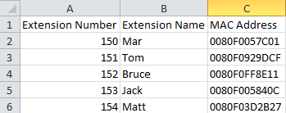

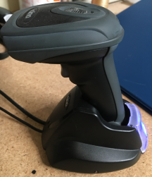
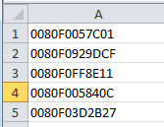
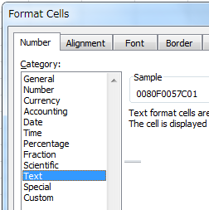

How to program? - NT registration by CSV -
Copy EXT number and Name from data base that user use
Prepare to create CSV file with MAC address -New Installation-
Use exported CSV file as template
CSV file prepared for import
Create CSV file contain
MAC Address info
Copy MAC Address information from scan data
MAC address label attached on carton box of NT
Scan MAC Address by
Scanning tool
Format Cell must be Text to present “0” at front

Slide 6
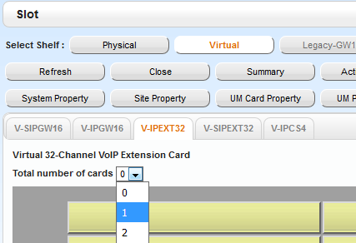
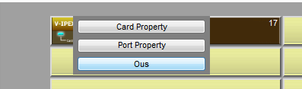
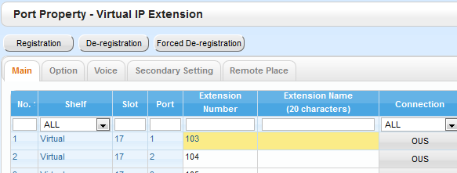
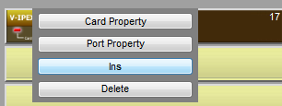
How to program? - NT registration by CSV -
Install V-IPEXT
OUS by card or port
Import CSV at Port Property screen
Check and confirm imported data and Save
CSV file prepared for import
INS by card or port
Registered and INS
-It is necessary to set “IP Terminal Registration Mode” as “Full Automatic” mode or PBX IP address need to set manually at NT phone side.

