Slide 1
KX-NS PBX
Remote IP Extension
April 17, 2014
Panasonic System Networks
PBX SE team
Specifications are subject to change without notice.
Notes:
1

Slide 2
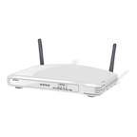


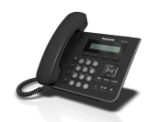
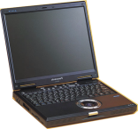
1. Overview
Built-in MRG feature supports remote IP extension without VPN.
MRG = Media Relay Gateway
Following phones support this feature.
- KX-NT543/NT546/NT560 (Version up of phone software is required.)
- KX-NT511 and KX-NT550 series
- KX-UT series
- 3rd party SIP phone with Blank UDP transmit capability. (Video phone is also supported.)
Other phones do not support this feature.
KX-UDT / KX-NT300 series / KX-NT300 based software phone
KX-NS1000 : Version 3 or later
Other KX-NS PBX : Any Version
Local Office
Remote Office
or Mobile Internet
WAN
11.22.33.44
WAN
22.33.44.55
Internet
192.168.0.101
LAN
192.168.0.1
LAN
Ext 101
192.168.0.201
Ext 103
Ext 102
192.168.1.201
IP address in this document is example.
Notes:
2

Slide 3
2. Concept of Programming
Only 3 PBX programming are required for remote connection.
(1) PBX has to know global IP address of router. 11.22.33.44
(2) Do not forget setting of default gateway. 192.168.0.1
(3) PBX has to know location of each IP extension. Local or Remote
Port Fwd is required to router.
(Not only 15060)
“5060” is too famous as port for SIP.
“5060” has high risk for attacking by hacker.
KX-UT in remote location uses port “15060” to
access PBX through router.
This document uses “15060” for other SIP phone also.
15060 to 192.168.0.101:5060
Local Office
Remote Office
or Mobile Internet
WAN
11.22.33.44
Port : 15060
WAN
22.33.44.55
Internet
192.168.0.101
Port : 5060
LAN
192.168.0.1
LAN
Ext 101
192.168.0.201
Ext 103
Ext 102
192.168.1.201
Notes:
3

Slide 4
Chapter 1
PBX Programming

Slide 5
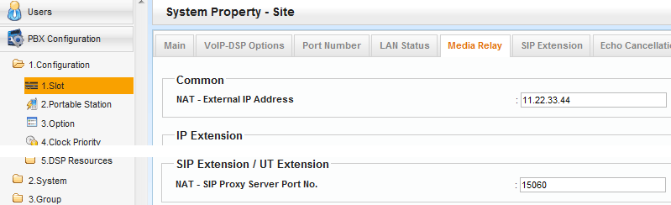
11. Assign Global IP Address of Router.
Local Office
Default is OK.
WAN
11.22.33.44
Port : 15060
192.168.0.101
Port : 5060
LAN
192.168.0.1
Ext 101
192.168.0.201
Notes:
5

Slide 6
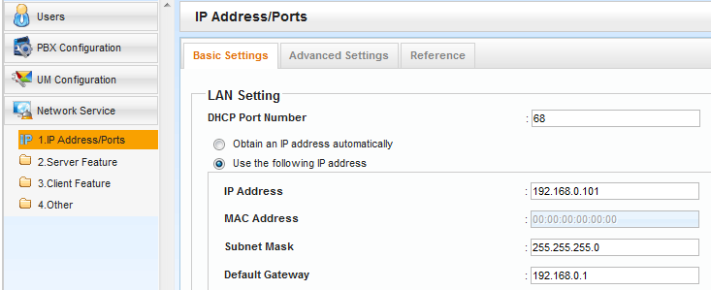
12. Assign Default Gateway.
Local Office
WAN
11.22.33.44
Port : 15060
Default gateway is required not only for remote IP extension but also for many other purpose.
192.168.0.101
Port : 5060
LAN
192.168.0.1
Ext 101
192.168.0.201
Notes:
6

Slide 7
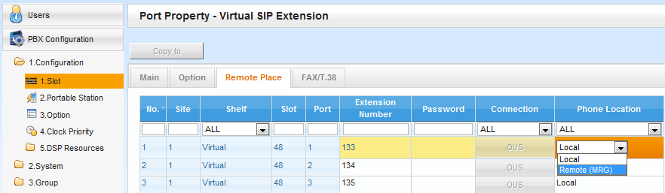
13. Assign Location of SIP Extension.
< 3rd party SIP Phone >
Local Office
Remote Office
or Mobile Internet
WAN
11.22.33.44
WAN
22.33.44.55
Internet
192.168.0.101
LAN
192.168.0.1
LAN
Ext 101
192.168.0.201
Ext 103
Ext 102
192.168.1.201
Notes:
7

Slide 8
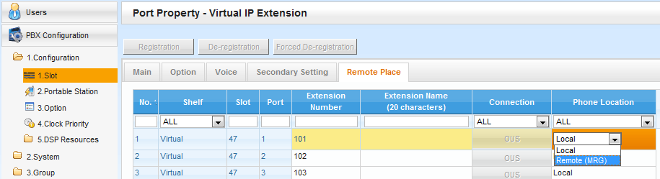
14. Assign Location of KX-NT500.
< KX-NT500 >
Notes:
8

Slide 9
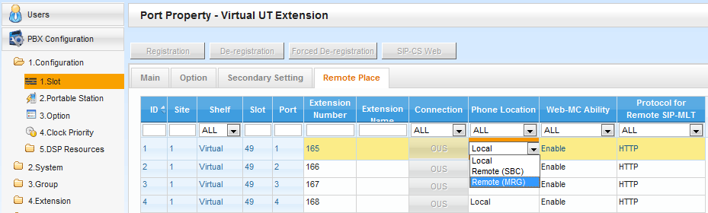

15. Assign Location of KX-UT.
< KX-UT >
SBC : Session Boarder Controller
(3rd party equipment is required.)
Secure communication is available using HTTPs for KX-UT.
- TR069(CWMP) is available with https.
- Maximum 20 KX-UT phone can use this feature.
Each one KX-NS1000 in one-look network supports 20 KX-UT
with this feature.
Notes:
9

Slide 10
Chapter 2
SIP Phone Setting
SIP Software Phone for Smart-phone by Media5 is used in this chapter as example.

Slide 11
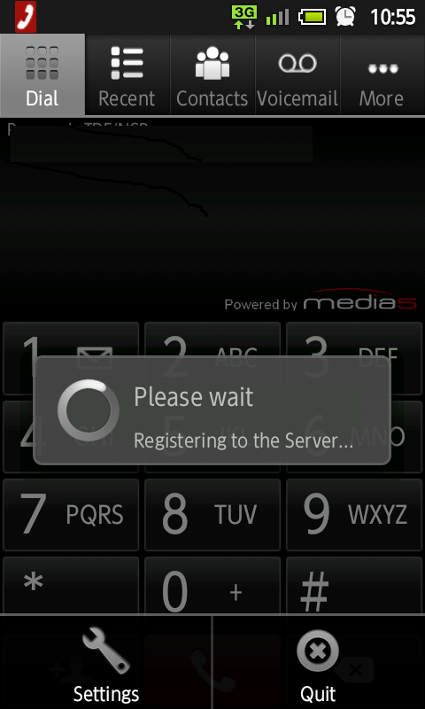
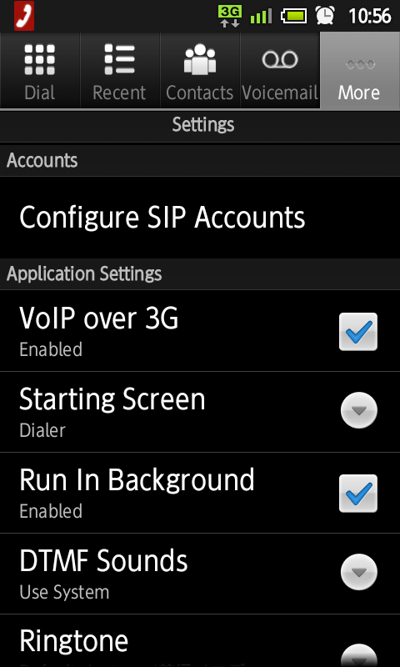
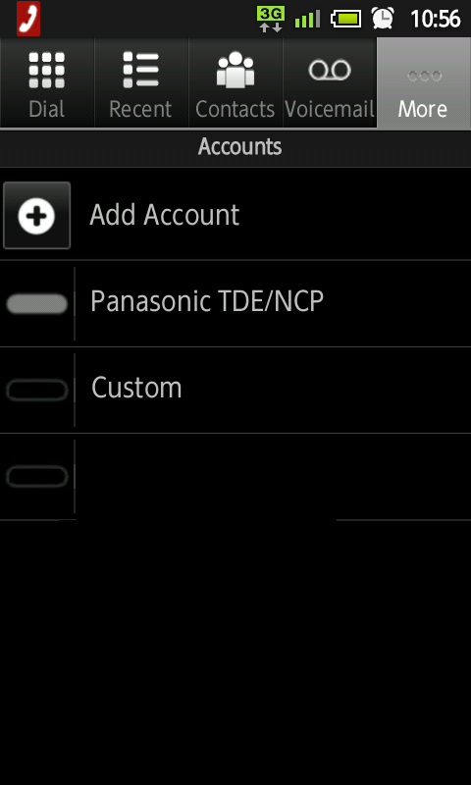
21. Configure SIP Account.
Notes:
11

Slide 12
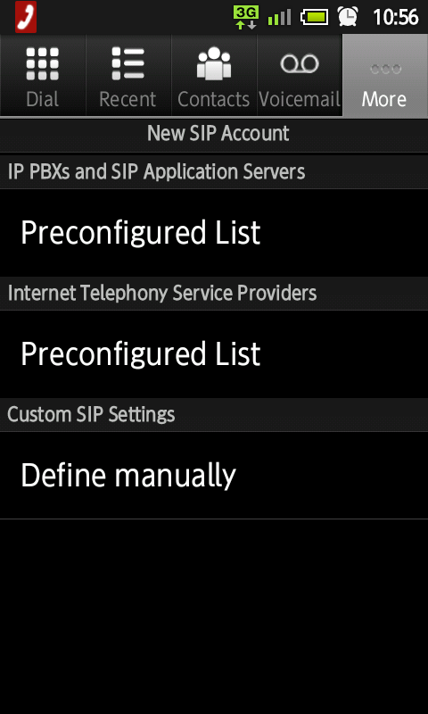
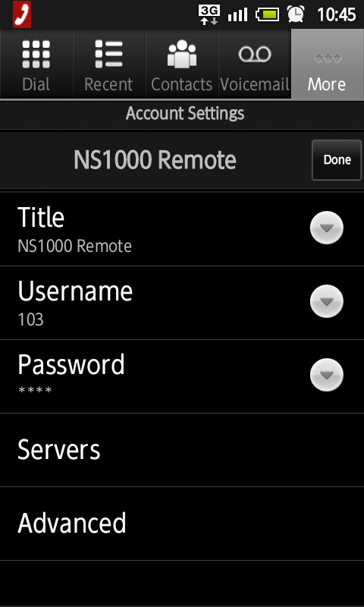
22. Assign Ext Number & PIN to log-in.
See next page.
Title = Reference
Username = Extension Number
Password = SIP Password of PBX
Notes:
12

Slide 13
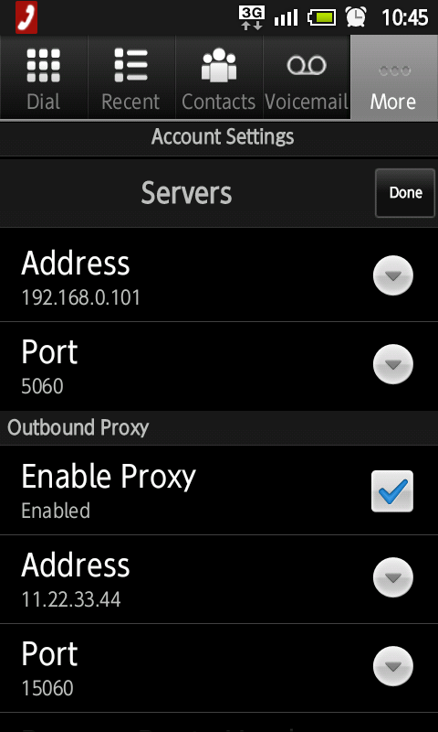
23. Assign Destination to log-in.
Local Office
WAN
11.22.33.44
Port : 15060
192.168.0.101
Port : 5060
LAN
192.168.0.1
Ext 101
192.168.0.201
Notes:
13

Slide 14
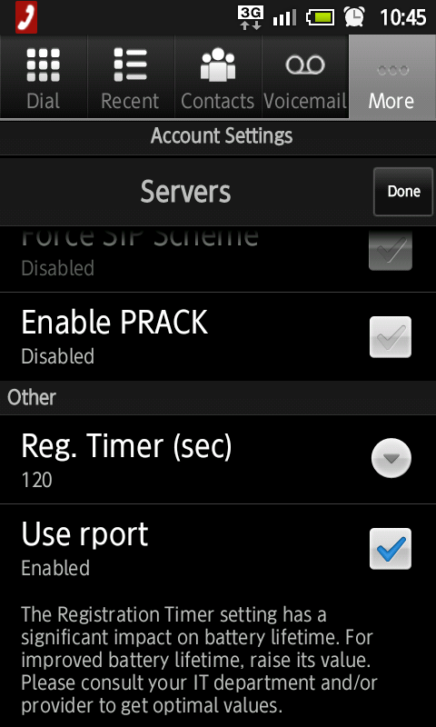
24. Enable “rport”.
Notes:
14

Slide 15
Chapter 3
KX-NT/UT Phone Setting

Slide 16
31. KX-NT500 : Assign Router as Destination.
Assign global IP address of router (11.22.33.44 for example) as destination instead of PBX local address (192.168.0.101 for example), when KX-NT phone is installed in remote office.
Local Office
Remote Office
or Mobile Internet
WAN
11.22.33.44
WAN
22.33.44.55
Internet
192.168.0.101
LAN
192.168.0.1
LAN
Ext 101
192.168.0.201
Ext 103
Ext 102
192.168.1.201
Notes:
16

Slide 17

32. KX-UT : Connect in Local Office.
1. Connect KX-UT phone in local office. (Not remote office)
2. Change PBX setting for this extension from “Local” to “Remote”.
3. Restart KX-UT by power off and on again. Error may display but OK.
4. Dispatch KX-UT to remote office.
Destination from remote office (11.22.33.44:15060 for example) is automatically informed to KX-UT phone from PBX at step 3.
Local Office
Remote Office
11.22.33.44
Port : 15060
WAN
11.22.33.44
Port : 15060
WAN
22.33.44.55
Internet
192.168.0.101
Port : 5060
192.168.0.1
LAN
Ext 101
192.168.0.201
Ext 102
192.168.1.201
Step 4
Dispatch
Ext 103
Ext 102
192.168.1.201
Operation is not required in remote office to connect KX-UT phone to PBX.
All you have to do is to connect KX-UT phone to LAN in remote office.
Notes:
17

Slide 18
Chapter 4
Router Programming
Port forwarding is required for router.

Slide 19
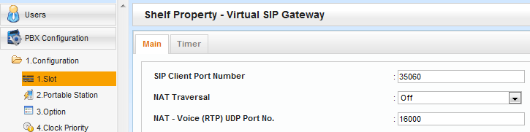
41. Port Fwd to DSP
< for 3rd party SIP Phone / KX-NT500 / KX-UT >
Protocol | Range of port number (WAN) | Destination | Description
RTP | 16000-16511(UDP) | 192.168.0.102 | to DSP#1-1
 | 16512-17023(UDP) | 192.168.0.103 | to DSP#1-2
 | 17024-17535(UDP) | 192.168.0.104 | to DSP#2-1
 | 17536-18047(UDP) | 192.168.0.105 | to DSP#2-2
WAN
LAN
< Reference of PBX setting >
Default is OK.
This parameter is common for IP trunk and IP extension.

Slide 20
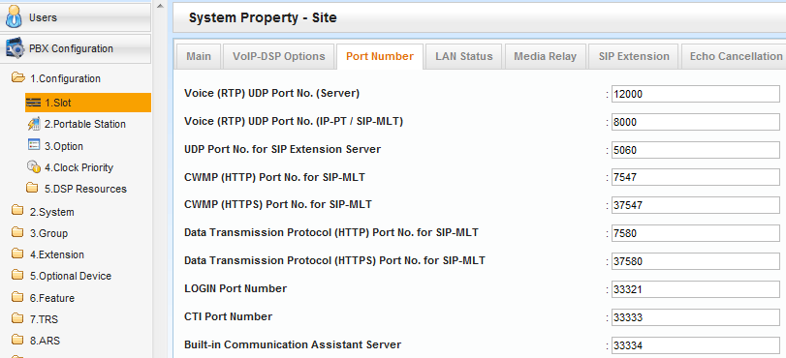
42. Port Fwd to PBX LAN : SIP
< for 3rd party SIP Phone >
Protocol | Port number | Destination
SIP | 15060(UDP) | 192.168.0.101:5060(UDP)
Port number conversion is required from 15060 to 5060.
< Reference of PBX setting >
Default is OK.

Slide 21
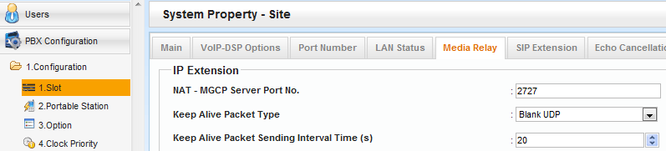
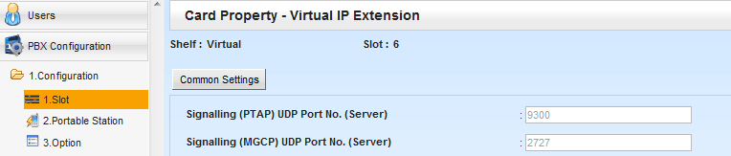
43. Port Fwd to PBX LAN : KX-NT500
< for KX-NT500 >
Protocol | Port number | Destination
MGCP | 2727(UDP) | 192.168.0.101
PTAP | 9300(UDP) | 192.168.0.101
< Reference of PBX setting >
Default is OK.

Slide 22
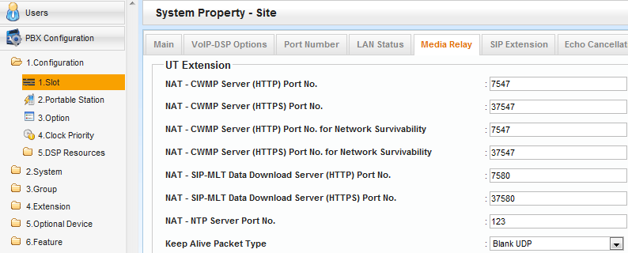
44. Port Fwd to PBX LAN : KX-UT
< for KX-UT >
Protocol | Port number | Destination
SIP | 15060(UDP) | 192.168.0.101:5060(UDP)
CWMP (HTTP) | 7547(TCP) | 192.168.0.101
CWMP (HTTPS) | 37547(TCP) | 192.168.0.101
SIP-MLT Data Download (HTTP) | 7580(TCP) | 192.168.0.101
SIP-MLT Data Download (HTTPS) | 37580(TCP) | 192.168.0.101
NTP | 123(UDP) | 192.168.0.101
< Reference of PBX setting > Default is OK.

Slide 23
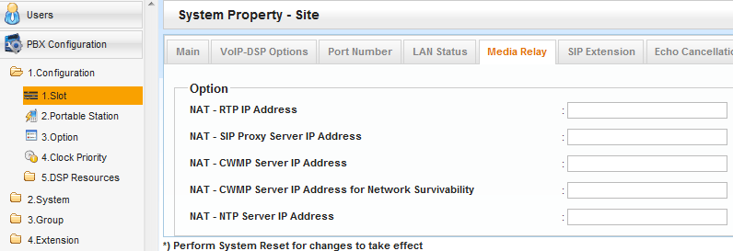
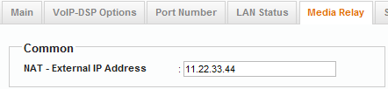
45. Port Fwd to PBX LAN : KX-UT
< Reference of PBX setting >
Default is OK. (These should be blank.)
This is applied to above,
if above is blank.

Slide 24
46. Condition for External Router
Condition for external router is only as follows.
- Many port fwd setting is required as previous pages.
But some router does not have enough number of port fwd setting.
(Range setting is not possible.)
- New router has "SIP ALG" feature.
But this feature should be disabled by programming.
- Some router by Cisco (Not all router by Cisco) does not have
compatibility for KX-NT500 remote connection.
(We inform details after investigation.)

Slide 25
Chapter 5
KX-NS1000 Built-in Router
MRG feature can work with KX-NS1000 built-in router.

Slide 26
51. Concept of Programming
Programming (1) and (3) are required for remote connection.
(1) PBX has to know global IP address of router. 11.22.33.44
(2) Default gateway programming 192.168.0.101 (No need)
(3) PBX has to know location of each IP extension. Local or Remote
Fixed global IP address for WAN is required as next page. 11.22.33.44
Other settings such as Port Fwd are NOT required.
Local Office
Activation key KX-NSN101 is required to use WAN.
WAN
11.22.33.44
Port : 15060
Remote Office
or Mobile Internet
WAN
22.33.44.55
Internet
192.168.0.101
Port : 5060
LAN
LAN
Ext 101
192.168.0.201
Ext 103
Ext 102
192.168.1.201
Notes:
26

Slide 27
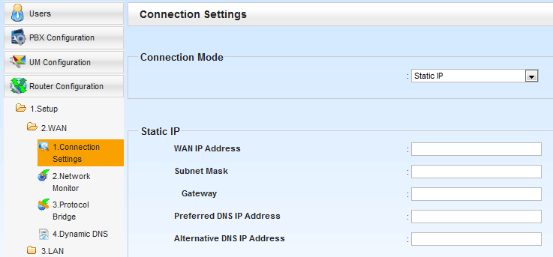
52. IP Address for WAN
Notes:
27

Slide 28
Thank you !

Slide 29
Revision
Date | No. | Change
April 17 | All | First release
Notes:
29

